Slide 1
Welcome, Parents!
欢迎
August 13th, 2019

Slide 2
Learn About Our Class
The teacher
Communications
A Day in your child’s life (schedule)
IB at ICSAtlanta
Subjects
Homework
Parent Portal
Schedule/Tardiness
Supplies
Questions?

Slide 3
Get to Know Me
My experience
My background
• This is my third year teaching in
ICSAtlanta.
I have been teaching for 17 years both in GA and in Taiwan.
Hobbies
• baking
• shopping
• traveling
I come from Taiwan.
I am married and have two children
I hold a Master Degree of Education

Slide 4
Communication
My email: kimberly.hsu@icsatlanta.org
School phone: 470-222-7420l
Blogs – you can just check in First Grade Blog http://icsatlanta1stgrade.edublogs.org/ weekly
and you will find my blog from there: http://kimberlyhsu.edublogs.org/
Blog Photo Password(sent it via email)
You can also find our blog by visiting our school website faculty page: http://www.icsatlanta.org
Please check it as often as possible as it is the best way to keep you posted as to what is happening in our school, in our classrooms!
I will send weekly classroom news and homework via email and post them on my blog.

Slide 5
Communications
Agenda:
    use for daily communications (e.g. inform teacher about Dr. appointment the next day, let teacher know about change in transportation).
    The teacher will also use it to communicate daily behavior
    Teachers will send home reminders to parents in the agenda.
    Please check it daily and initial!
Communication Folder: The orange folder
    our child’s work will be sent home on Fridays.
    In the orange folder, you will also find the homework, scholastic flyers, PTO flyers, school communications, etc.
    Please empty and look over all materials sent home.
    Please take the time and talk to your child about the work he/she did in class.

Slide 6
Communication continued
Conferences:
It will be during the week of October 14th-17th (in the afternoons).
I will send a sign-up genius link for you to reserve a time slot

Slide 7
Classroom Schedule
7:20- 7:40 | Morning Work(Writing /math) School starts, Attendance(7:40)
7:45 - 9:15 | POI
9:15– 9:30 | Snack Break Wed.: 10:10-10:25
9:30 - 9:45 | Calendar Time
9:45 – 10:40 | English Wed.: 9:21-10:06
10:45 - 11:25 | Specials
11:25- 11:40 | Math number talk
11:45 – 12:10 | Lunch
12:15 - 12:40 | Recess
12:45 – 2:05 | Math centers/Mandarin
2:10-2:20 | Get Ready for Dismissal
We have PE on Tuesday and Thursday.
We have Art on Monday.
We have music on Friday.
We have HWT on Tuesday and Friday.

Slide 8
Class Goals
Be nice and respect each other
Be responsible
Working independently
Manage time effectively
Have fun in learning Mandarin
Can speak daily and basic conversation in Mandarin
Can read simple sentences and do a little more writing

Slide 9
Classroom Community
Our classroom rules help us get along with each other:
  Be respectful and responsible. (Be nice!)
  Use appropriate voice level (arrival, dismissal, hallways – silent)
  Use walking feet
  Be organized and follow directions.
  Work hard & have fun

Slide 10
Blue Tickets/Gold Coin
How can they get blue tickets/gold coins? (In class, In the hallway, lunch time, good behavior, improve or make progress…turn in homework on Friday)
-- Collect blue tickets/gold coins can get the chance for treasure box or more

Slide 11
Reading - Mandarin
1st Mandarin students will learn Mandarin by “My First Chinese Reader”.
There are 24 books in “My First Chinese Reader”.
Practicing their writing(Chinese stroke, sight words, copy words and sentence, write their own sentence with drawing, Journal…)
I use Quizlet to show Mandarin and PYP unit vocabularies they learned during the week and English meaning for parents. You can also find some games or fun activities there. It is very helpful to review the vocabularies when they have a quiz.

Slide 12
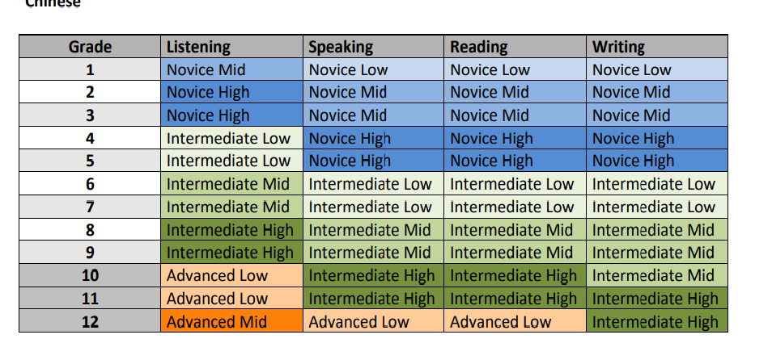
Mandarin Proficiency Targets
ACTFL guideline
https://www.actfl.org/publications/guidelines-and-manuals/actfl-proficiency-guidelines-2012/chinese

Slide 13
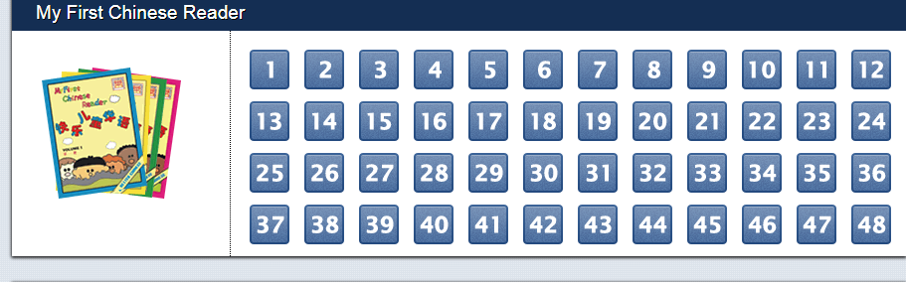
1st Grade
Mandarin Textbooks：My First Chinese Reader (lesson 1-24) from Better Chinese Publisher. We will do guided reading at school to help kids improve their listening and speaking proficiency levels as well as some characters identification. Differentiated instruction will be implemented to meet all kids’ needs.
Math and PYP will follow Georgia Common Core Standards and IB. Math will use Envision Math.
Recommended Story Reading at home using AI library reading system
Each student will have an account.

Slide 14
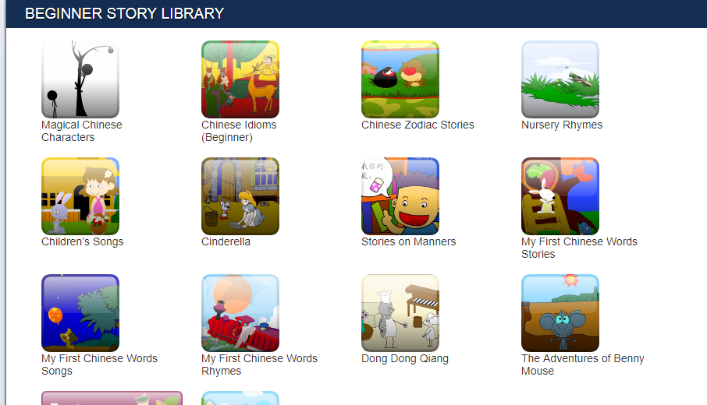
AI Library Books

Slide 15
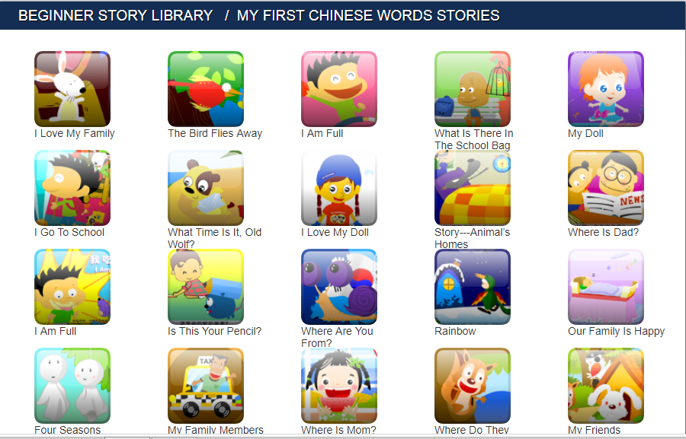

Slide 16
Extra Resources
If you want to buy your own resources, you can go to the following link:
https://www.betterchinese.com/collections/my-first-chinese-reader-student-materials
Free resources:
http://www.yes-chinese.com/
https://www.youtube.com/channel/UCttafJi4SCirZhlxsxISbyA
https://www.youtube.com/channel/UCrLO-yoAu4ZTzRSdmWqS53A

Slide 17
What is IB?
What is IB?
IB stands for International Baccalaureate
We are an IB World school. We were authorized over the summer.
The International Baccalaureate (IB) aims to develop inquiring, knowledgeable and caring young people who help to create a better and more peaceful world through intercultural understanding and respect...
The Primary Years Programme (PYP) encourages students across the world to
become active, compassionate and lifelong learners who understand that
other people, with their differences, can also be right.
The PYP is a program for our students in Kindergarten to our 5th grade.

Slide 18
What is IB?
What does it mean for your child?
more transdisciplinary in his learning: more connections to what he is learning in another subject area
learner profiles/traits and attitudes that will help him/her better himself as a student but also as a person, as a citizen of the world

Slide 19
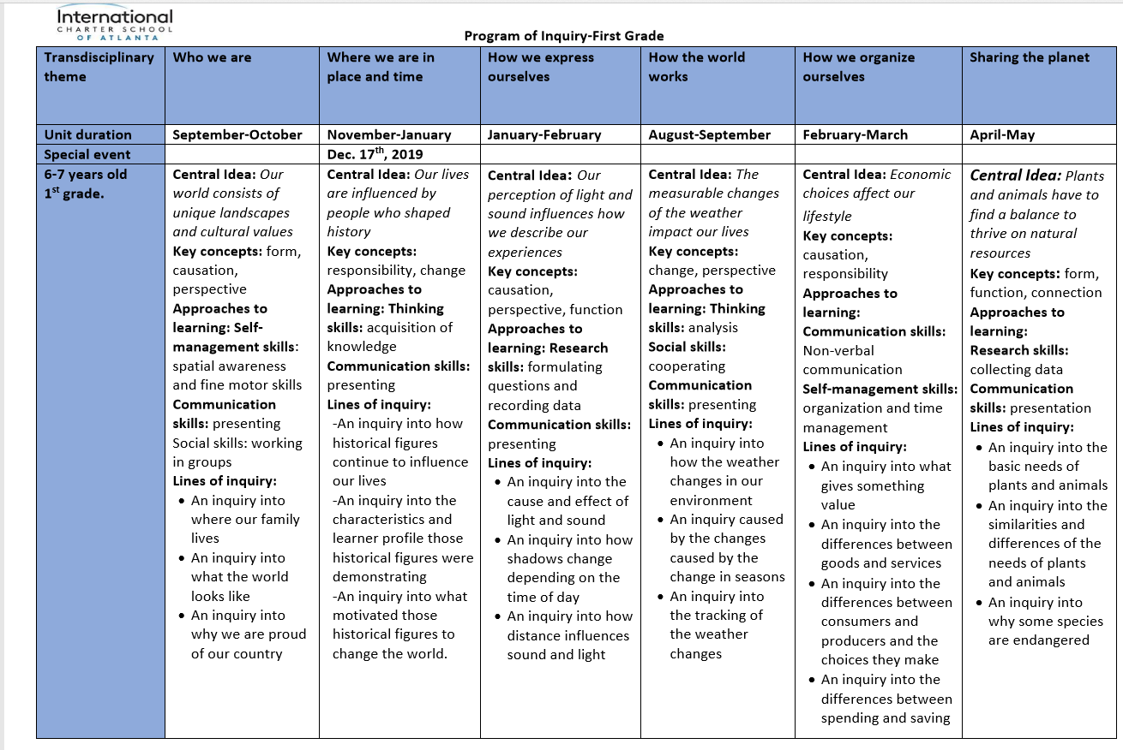
Program of Inquiry

Slide 20
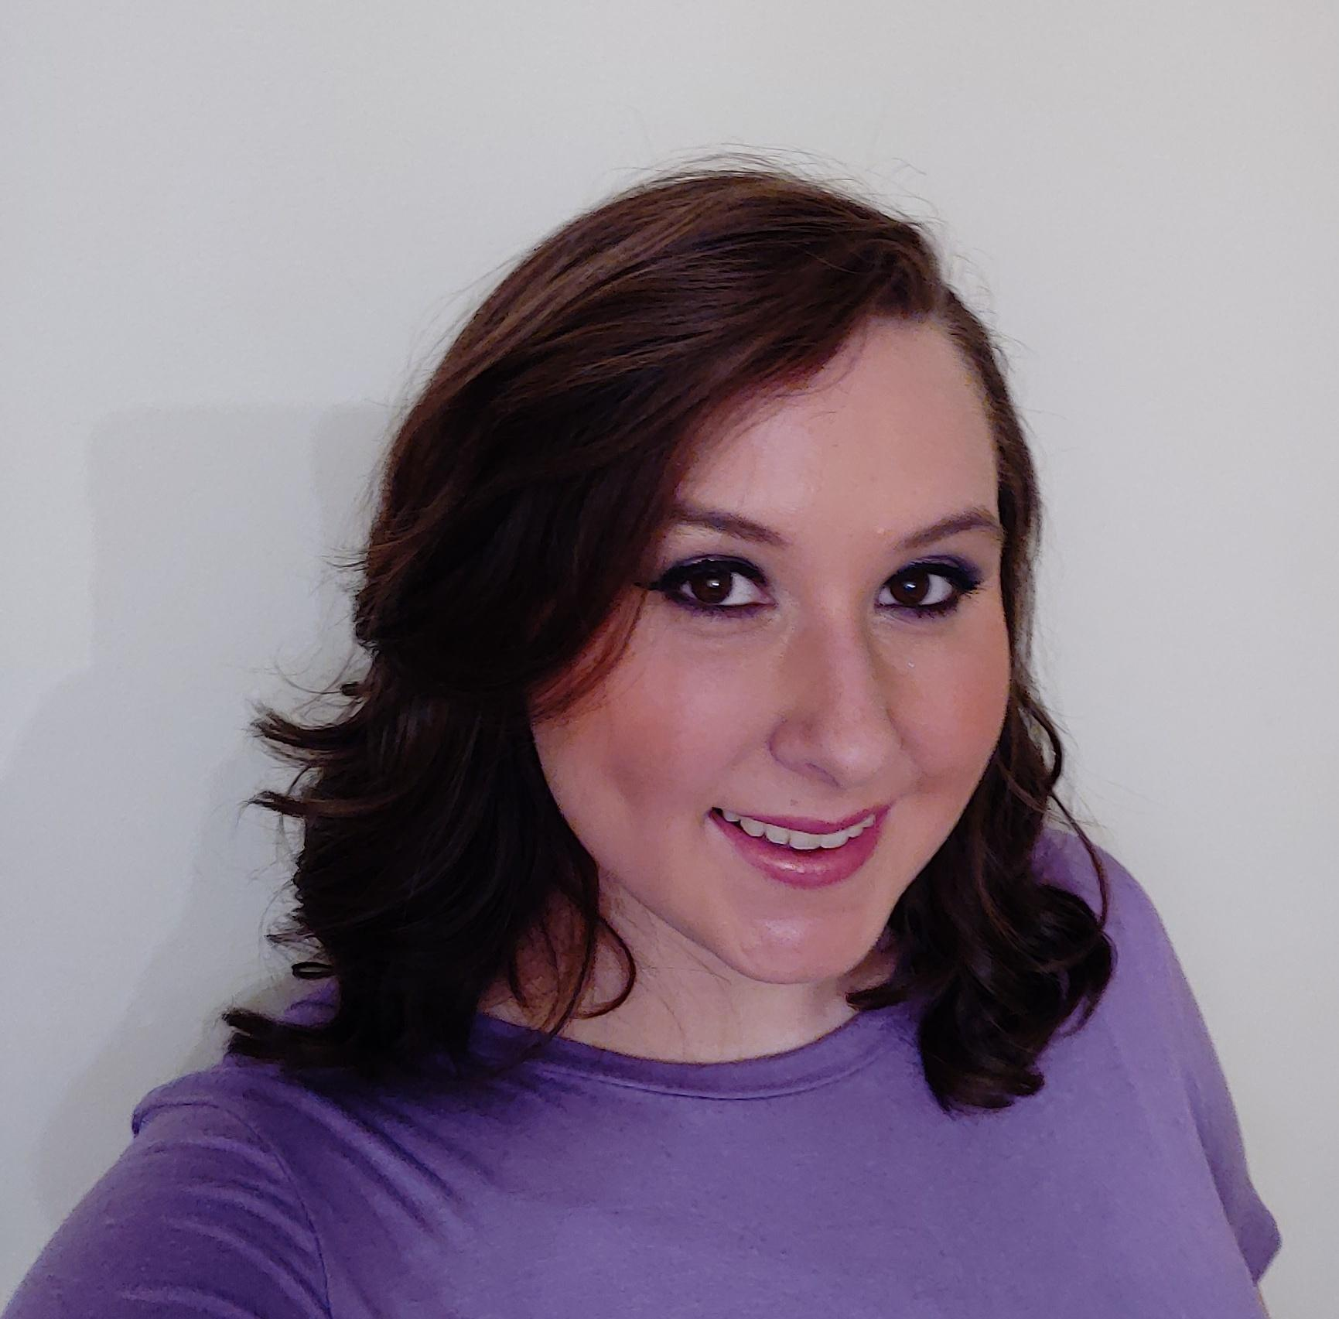
Music
EDUCATION
Rome High School
Rome, GA
Graduation May 2010
Jacksonville State University
Jacksonville, AL
August 2010 - December 2015
Bachelor of Arts in
Music Education
As a JSU student, I played trumpet in the Marching Southerners and sang Soprano in A Capella Choir, Chamber Singers, and Show Choir. I also participated in many productions with the Jacksonville Opera Theatre.
In my spare time, I love to watch TV, play video games on my phone, and cuddle with my 2 cats.
Ms. Lacy Taylor
Teaching Experience
FAVORITES
2019-2020 is my first year with ICSAtlanta, but I taught elementary music (K-4) in Oxford, Alabama for 3 years prior. I also had the opportunity to co-direct an elementary choir.
Color: purple Chocolate: Snickers
Food: corn (any kind) Candy: Gummies
Animal: butterfly

Slide 21

Music Curriculum
Quaver Music is an excellent education resource that I will be using this year to help your students learn about and enjoy music.
Standards:
National Association for Music Education (NAfME)
Georgia Standards of Excellence (GSE)
Georgia Performance Standards (GPS)
Students will learn to:
Read music,
Compose music,
Appreciate music through all cultures,
Play various musical instruments,
Dance & move appropriately to music,
And so much more.
PYP: Every student that attends music at ICSAtlanta will have multiple opportunities in every lesson to connect to the units of inquiry via the key concepts, as well as the other academic subjects.
Music is at the heart of all we do.
Located at the crossroads of Music Row in Nashville, TN, QuaverMusic was founded on the power of music. Our dedicated staff of over 100 employees works full time to develop music-based teaching resources quickly and stay on the cutting-edge of education and technology.
Technology is what we know.
We have been developing online curricula for over 7 years. We’re not just digitizing textbooks, but creating truly interactive content optimized for classroom bandwidth along with backup resources for Internet down days.
More info? Visit www.quavermusic.com

Slide 22
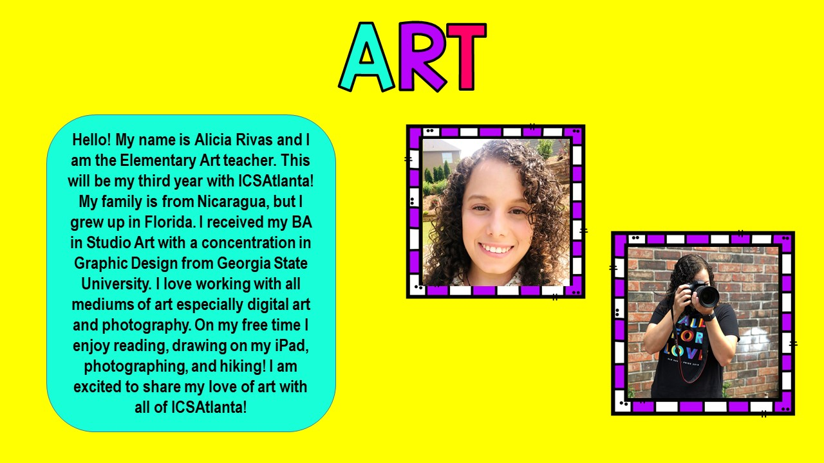
Art Teacher

Slide 23
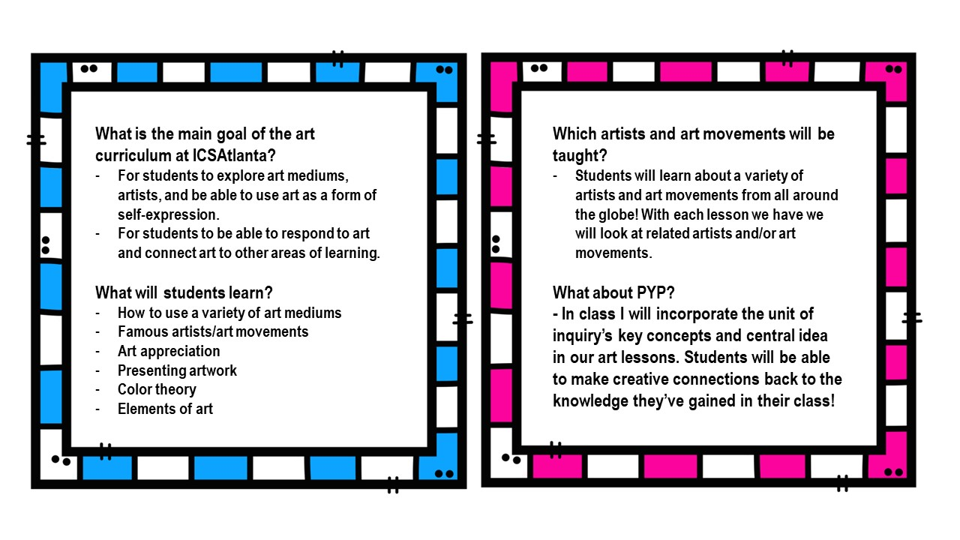
Art

Slide 24
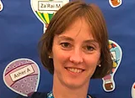
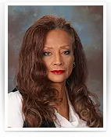
PE- About Mrs.Shepherd and Ms Beauchamps
PE Teacher
I am Mrs. Shepherd and will be your students physical education teacher. I am a native German speaker and graduated from KSU with a Bachelor of Science in Health and Physical Education. I have worked in the past as an Moid teacher as well as taught Adapted Pe. In Germany I received my associate degree and finished with a “Certificate for the Hotel and Catering Business” working in hotels in Germany and the US.
Pe Paraprofessional
I am very excited to announce that we are welcoming Ms. Holley our parapro back, who also by the way teaches martial art on the weekend. She has great knowledge and is an instructor in martial arts, self defense and loves children. She has a black belt in Japanese karate, black belt in Muay Thai Kickboxing and self defense, and a blue belt in Brazilian Jiu Jitsu!!!

Slide 25
Handwriting Without Tears(HWT)
Research shows HWT helps improve students writing quality and quantity in a short period of time.
We will be using HWT to help students learn to form their letters and numbers correctly.
HWT is a fun program that uses songs and activities to help keep students engaged and promotes a stress free learning environment.
All Kindergarten and 1st grade students will use the Handwriting Without Tears program in their classrooms.

Slide 26
Homework
Will be sent home on Friday
Math homework: Students will practice skills on Mobymax 45 minutes a week (about 11-12 minutes a night Monday-Thursday). Specific standards will be assigned per week
MLA: Vocab. review weekly from Quizlet or I will assign AI online reading
ELA: Spelling, Phonics, Reading homework (Modes of homework will vary. We will start using online resources to assign homework specific to each student. I will also send home anything that may need to be completed at home and returned to class. You should be reading with your child every night! Bedtime stories count and so does learning how to sound out words!
PYP: Vocab. review weekly from Quizlet
sometimes a take home project/research/
Homework example

Slide 27
Grade
Standards-based report cards: Students will receive a 1,2,3, or 4
Grade-level expectation is 3
4 is above grade level expectation
2: student is not consistently reaching the grade level
1: student is not reaching grade level most of the time
The parent portal will open/is opened; if you did not receive the instructions to access the portal, email info@icsatlanta.org
The parent portal allows you to see your child’s attendance and grades
Returning parents use the same login as last year

Slide 28
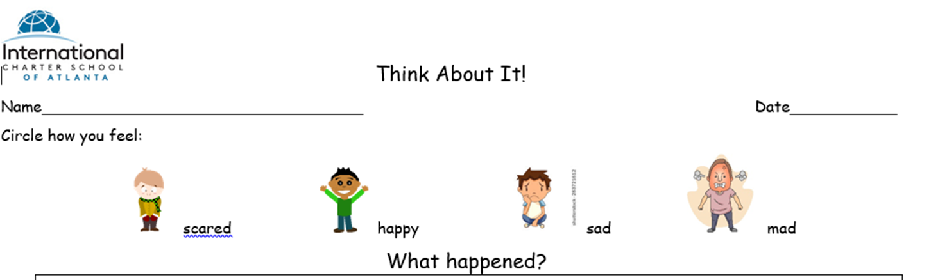
Discipline
Behavior chart-explain colors/how it works (3 warnings)
How parents will be informed
Use of the agenda
“Think about it” reflection
No tolerance for bullying
Blue and yellow tickets
Gold Coins

Slide 29
Tardiness
School starts at 7:40 A.M.
Attendance is mandatory in the state of Georgia.
Running late?
  Check in at the school office before coming to class.
  Your child will get a tardy slip to present to the teacher
Early Pick up?
  Mon., Tues., Thurs., Fri. - pick up by 1:40 pm
  Wed. - pick up by 12:40 pm
  Otherwise pick up through regular carpool line

Slide 30
How to reach me
Email: kimberly.hsu@icsatlanta.org
Allow up to 48 hours for a reply
Leave note in the agenda
Initial agenda to show that you have read it every evening
Check blog regularly/weekly

Slide 31
Supplies
THANK YOU FOR SENDING IN YOUR SCHOOL SUPPLIES AND CLASS WISH LISTS.
I TRULY APPRECIATE THEM!
Don’t bring these items
Electronic Devices, phones, watch phones, etc. unless specifically allowed by teacher for an activity.
Toys (incl. Fidget Spinners)

Slide 32
Online Resources
Clever: Students have received one login username and password for this site
The online resources will be available from here: Mobymax, MyOn, Spelling City, typing, Linguascope… like apps
This is where the students will go for homework online or practice at home or at school
Login info:
  https://clever.com/in/international-charter-school-of-atlanta874cb2e000143dfdf
  Username: Student ID # (on parent portal and check your email I sent)
  Password: learn123
  In clever, Linguascope: password: learn
  It will be on your child’s agenda!

Slide 33
Online Resource
Chinese Online Resource:
Recommended Story Reading at home using AI library reading system.
Each student will have an account.
Quizlet:
https://quizlet.com/join/ukUxYMMbk

Slide 34
Attendance Information
https://drive.google.com/file/d/1hOFTHG2a7vmxKprimy7UNzn4TQpbhqMv/view?usp=sharing

Slide 35
Questions?

Slide 36
Let’s Have a Great Year!
谢谢大家

